Slide 1

Micro
ECON
McEachern 2010-2011
5
CHAPTER
Elasticity of
Demand and Supply
Designed by
Amy McGuire, B-books, Ltd.
Notes:
Chapter 5 Elasticity of Demand and Supply

Slide 2

Price Elasticity of Demand
Elasticity
  Responsiveness
Price elasticity of demand
  Consumers’ responsiveness to a change in price
  Percentage change in quantity demanded divided by percentage change in price
LO¹
Notes:
Chapter 5 Elasticity of Demand and Supply

Slide 3
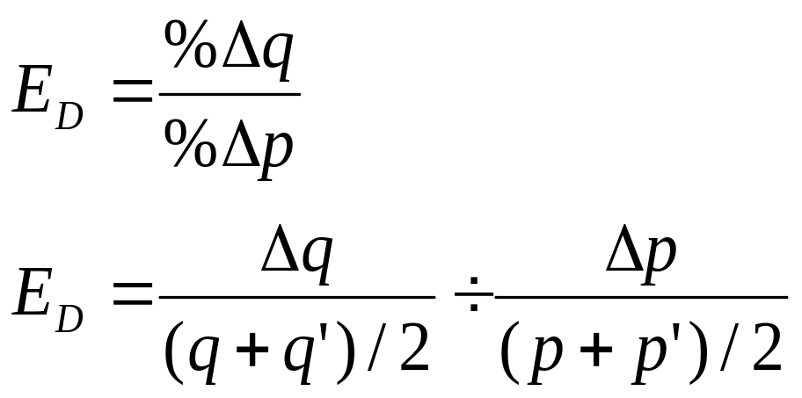
Price Elasticity of Demand
Law of demand
E_{D} negative
Absolute value of E_{D} positive
LO¹
Notes:
Chapter 5 Elasticity of Demand and Supply

Slide 4
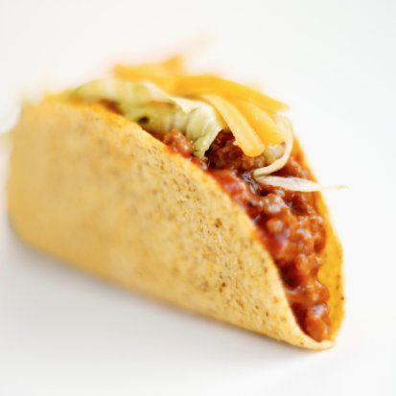
LO¹
Demand Curve for Tacos
If the price of tacos drops from $1.10 to $0.90, the quantity demanded increases from 95,000 to 105,000.
$1.10
a
Exhibit 1
b
0.90
Price per taco
D
95
0
105
Thousands per day
Notes:
Chapter 5 Elasticity of Demand and Supply

Slide 5

Categories of E_{D}
If %∆q < %∆p
  E_{D} between 0 and 1
  Inelastic D
If %∆q > %∆p
  E_{D} greater than 1
  Elastic D
If %∆q = %∆p
  E_{D} = 1
  Unit elastic D
LO¹
Notes:
Chapter 5 Elasticity of Demand and Supply

Slide 6

Elasticity and Total Revenue
Total revenue = price * quantity demanded at this price
TR= p * q
As p decreases
  If D elastic, TR increases
  If D inelastic, TR decreases
  If D unit elastic, TR unchanged
LO¹
Notes:
Chapter 5 Elasticity of Demand and Supply

Slide 7
Price Elasticity and the Linear D Curve
Linear D curve
  Constant slope
  Different elasticity
  D becomes less elastic as we move downward
D upper half: elastic
D lower half: inelastic
D midpoint: unit elastic
LO¹
Notes:
Chapter 5 Elasticity of Demand and Supply

Slide 8
Exhibit 2
LO¹
$100
(a) Demand and price elasticity
Demand, Price Elasticity, and Total Revenue
90
a
Elastic, E_{D} >1
80
70
b
Price per unit
60
Unit elastic, E_{D} =1
50
40
c
Inelastic, E_{D} <1
Where D is elastic, a lower P increases TR
30
20
Where D is inelastic, a lower P decreases TR
10
d
e
D
100
200
500
800
900
0
1,000
Quantity per period
(b) Total revenue
$25,000
Total
revenue
TR reaches a maximum at the rate of output where D is unit elastic
Total revenue
0
500
1,000
Quantity per period
Notes:
Chapter 5 Elasticity of Demand and Supply

Slide 9
Constant-Elasticity Demand Curves
Perfectly elastic D curve
  Horizontal; E_{D} = ∞
  Consumers don’t tolerate P increases
Perfectly inelastic D curve
  Vertical; E_{D} = 0
  ‘Price is no object’
Unit-elastic D curve
  %∆p causes an exact opposite %∆q
LO¹
Notes:
Chapter 5 Elasticity of Demand and Supply

Slide 10
Exhibit 3
LO¹
Constant-Elasticity Demand Curves
(a) Perfectly elastic
(b) Perfectly inelastic
(c) Unit elastic
D’
Price per unit
Price per unit
Price per unit
E_{D ’’} = 1
E_{D’’} = 0
E_{D} = ∞
$10
a
p
D
b
6
D’’
0
60
100
0
Quantity per period
0
Q
Quantity
per period
Quantity
per period
Consumers demand all quantity offered for sale at p, but demand nothing at a price above p
Consumers demand Q regardless of price
Total revenue is the same for each p-q combination
Notes:
Chapter 5 Elasticity of Demand and Supply

Slide 11
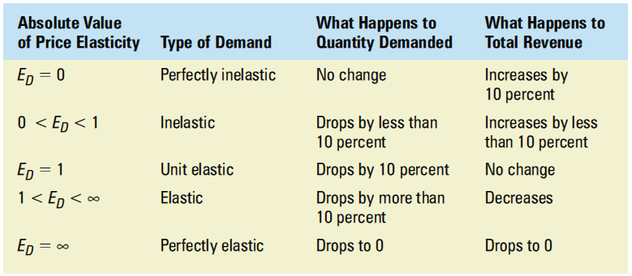
Exhibit 4
LO¹
Summary of Price Elasticity of Demand
Effects of a 10 Percent Increase in Price
Notes:
Chapter 5 Elasticity of Demand and Supply

Slide 12
Determinants of Price
Elasticity of D
E_{D} is greater:
  The greater the availability of substitutes, and the more similar the substitutes
  The more important the good as a share of the consumer’s budget
  The longer the period of adjustment (time)
LO²
Notes:
Chapter 5 Elasticity of Demand and Supply

Slide 13
Exhibit 5
LO²
Demand Becomes More Elastic over Time
D_{w}: one week after the price increase
$1.25
D_{m}: one month after the price increase
Price per unit
D_{y}: one year after the price increase
1.00
e
D_{y}
D_{w}
D_{m}
0
50
75
95
100
Quantity per day
D_{y} is more elastic than D_{m} , which is more elastic than D_{w}
Notes:
Chapter 5 Elasticity of Demand and Supply

Slide 14
Elasticity Estimates
Short run
  Consumers have little time to adjust
Long run
  Consumers can fully adjust to a price change
Demand is more elastic in the long run
LO²
Notes:
Chapter 5 Elasticity of Demand and Supply

Slide 15
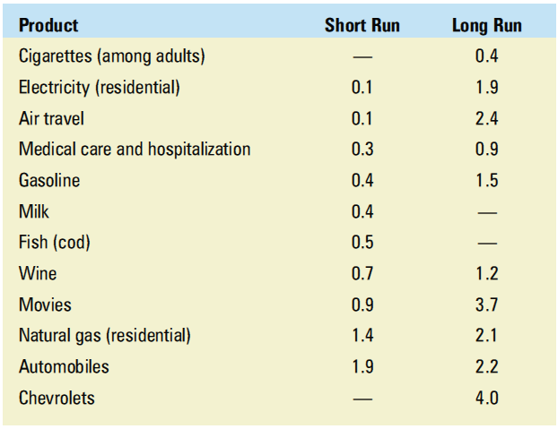
LO²
Selected Price Elasticities of Demand (Absolute Values)
Exhibit 6
Notes:
Chapter 5 Elasticity of Demand and Supply

Slide 16

LO²
Deterring Young Smokers
Health hazard
  Kills 440,000 Americans a year
    Lung cancer; Heart disease; Emphysema; Stroke
Cost to society
  $7.18 per pack sold
    Higher health cost
    Lost worker productivity
  Total: $150 billion a year
    $3,400 per smoker per year
Case Study
Notes:
Chapter 5 Elasticity of Demand and Supply

Slide 17

LO²
Deterring Young Smokers
Discouraging smoking
  Prohibit the sale of cigarettes to minors
  Higher cigarette tax
    E_{D} is higher for teens
      Big share of budget
      Less peer pressure
      Not an addiction yet
    Reduces teen smoking
  Change consumer tastes
Case Study
Notes:
Chapter 5 Elasticity of Demand and Supply

Slide 18
Price Elasticity of Supply
Elasticity
  Responsiveness
Price elasticity of supply
  Producers’ responsiveness to a change in price
  Percentage change in quantity supplied divided by percentage change in price
LO³
Notes:
Chapter 5 Elasticity of Demand and Supply

Slide 19

Price Elasticity of Supply
Law of supply
E_{S} positive
LO³
Notes:
Chapter 5 Elasticity of Demand and Supply

Slide 20
Exhibit 7
LO³
Price Elasticity of Supply
S
If the price increases from p to p’, the quantity supplied increases from q to q’.
Price and quantity supplied move in the same direction, so the price elasticity of supply is a positive number.
p’
Price per unit
p
0
q
q’
Quantity per period
Notes:
Chapter 5 Elasticity of Demand and Supply

Slide 21

Categories of E_{S}
If %∆q < %∆p
  E_{S} between 0 and 1
  Inelastic S
If %∆q > %∆p
  E_{S} greater than 1
  Elastic S
If %∆q = %∆p
  E_{S} = 1
  Unit elastic S
LO³
Notes:
Chapter 5 Elasticity of Demand and Supply

Slide 22
Constant-Elasticity Supply Curves
Perfectly elastic S curve
  Horizontal; E_{S} = ∞
  Producers supply 0 at a price below P
Perfectly inelastic S curve
  Vertical; E_{S} = 0
  Goods in fixed supply
Unit-elastic S curve
  %∆p causes an exact opposite %∆q
  S curve is a ray from the origin
LO³
Notes:
Chapter 5 Elasticity of Demand and Supply

Slide 23
Exhibit 8
LO³
Constant-Elasticity Supply Curves
(a) Perfectly elastic
(b) Perfectly inelastic
(c) Unit elastic
S’
S’’
E_{S’’} = 1
Price per unit
Price per unit
Price per unit
E_{S’} = 0
E_{S} = ∞
$10
p
S
5
10
20
0
Q
0
Quantity
per period
0
Quantity
per period
Quantity
per period
Firms supply any amount of output demanded at p, but supply 0 at prices below p.
Quantity supplied is independent of the price
Any %∆p results in the same %∆q supplied.
Notes:
Chapter 5 Elasticity of Demand and Supply

Slide 24

Determinants of Supply Elasticity
E_{S} is greater:
  If the marginal cost rises slowly as output expands
  The longer the period of adjustment (time)
LO³
Notes:
Chapter 5 Elasticity of Demand and Supply

Slide 25
Exhibit 9
LO³
Supply Becomes More Elastic over Time
S_{w}
S_{m}
S_{w}: one week after the
price increase
S_{y}
$1.25
S_{m}: one month after the
price increase
Price per unit
1.00
S_{y}: one year after the
price increase
0
100
110
140
200
Quantity per day
S_{w} is less elastic than S_{m}, which is less elastic than S_{y}
Notes:
Chapter 5 Elasticity of Demand and Supply

Slide 26
Income Elasticity of Demand
Demand responsiveness to a change in consumer income
Percentage change in demand divided by the percentage change in income that caused it
Inferior goods
  Negative income elasticity
Normal goods
  Positive income elasticity
LO⁴
Notes:
Chapter 5 Elasticity of Demand and Supply

Slide 27
Income Elasticity of Demand
Normal goods
  Income inelastic
    Elasticity between 0 and 1
    Necessities
  Income elastic
    Elasticity > 1
    Luxuries
LO⁴
Notes:
Chapter 5 Elasticity of Demand and Supply

Slide 28
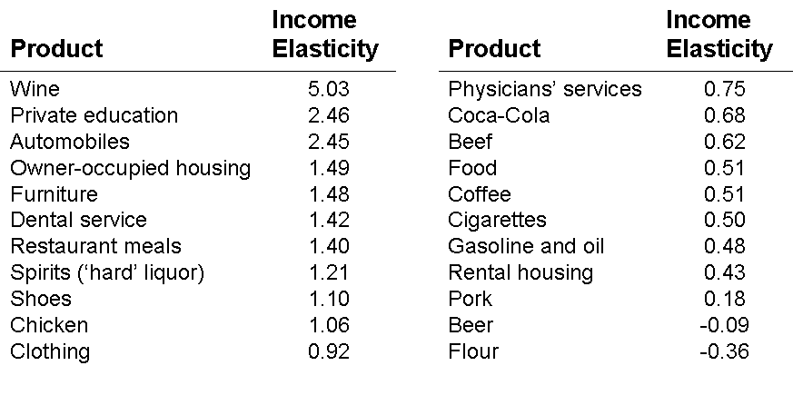
Exhibit 10
LO⁴
Selected Income Elasticities of Demand
Notes:
Chapter 5 Elasticity of Demand and Supply

Slide 29

LO⁴
The Market for Food and ‘The Farm Problem’
1950: 10 million family farms
Today: less than 3 million
Demand
  Price inelastic
    Total revenue falls when P falls
  Income inelastic
    D increases
Technological improvements
    S increases
Case Study
Notes:
Chapter 5 Elasticity of Demand and Supply

Slide 30
The Demand for Grain
The D for grain tends to be inelastic.
As the market P falls, so does TR.
$5
Price per bushel
4
3
2
1
D
LO⁴
0
5
10
11
Billions of bushels per year
Notes:
Chapter 5 Elasticity of Demand and Supply

Slide 31
LO⁴
The Effect on Increases in Demand and
Supply on Farm Revenue
S
$8
S’
Technological advance
- sharp increase in S
Increase in consumer income
- small increase in D
Drop in P
Drop in total revenue
Exhibit 11
Price per bushel
4
D’
D
0
5
10
14
Billions of bushels per year
Notes:
Chapter 5 Elasticity of Demand and Supply

Slide 32
Cross-Price Elasticity of Demand
Responsiveness of D for one good to changes in P of another good
%∆ in demand for one good divided by %∆ in price of another good
  If positive: substitutes
  If negative: complements
  If zero: unrelated
LO⁴
Notes:
Chapter 5 Elasticity of Demand and Supply

